Slide 1

Predicting Fe Material Properties Using Behler–Parrinello Neural Networks
Team:
Saharsh Sharma (22MMB0A12)
P. Varun Kumar (22MMB0A78)

Slide 2
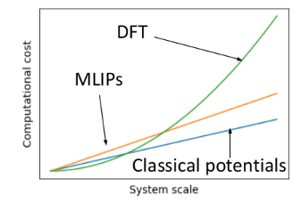
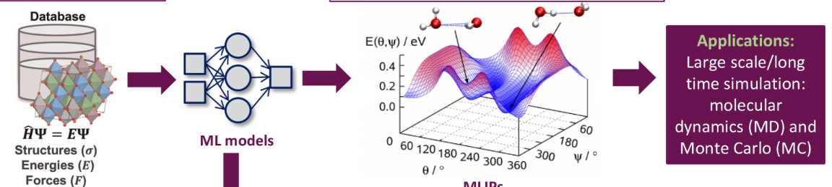
Motivation & Objective
Problem
Density Functional Theory (DFT) provides highly accurate predictions for materials’ properties (e.g., energy, forces, magnetism).
However, it is computationally expensive — scaling poorly with system size and requiring long simulation times for even simple structures.
Machine Learning (ML) offers a faster alternative by learning the mapping between atomic configurations and their corresponding energies or properties from DFT-generated data.
Objective:
Use ML models to predict thermal, electrical, and magnetic properties of Iron (Fe) as a function of lattice constant and temperature, reducing computation time while maintaining near-DFT accuracy.

Slide 3
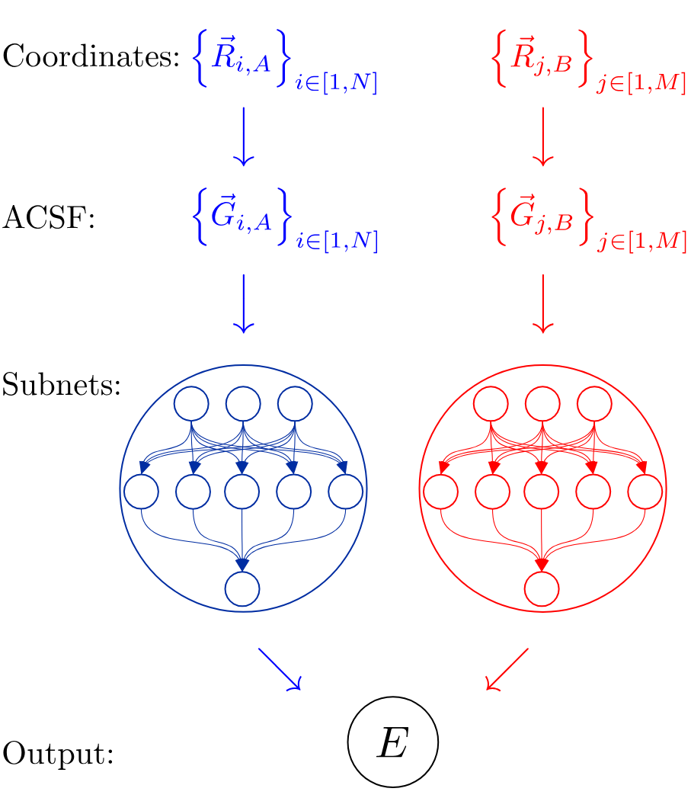
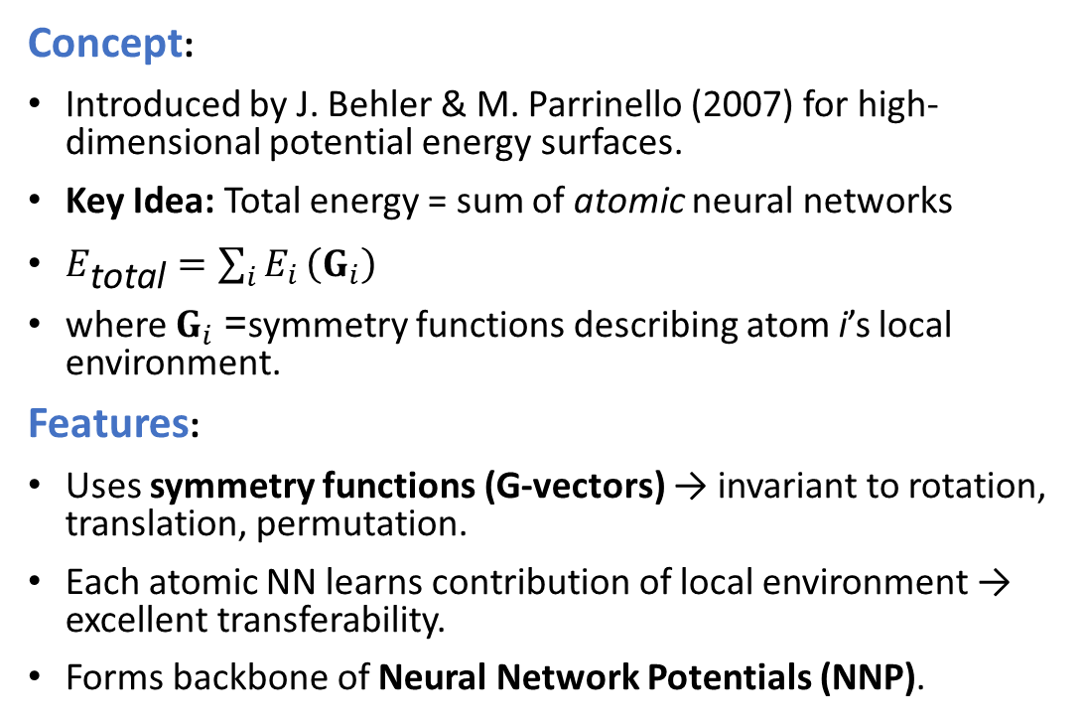
What Is a Behler–Parrinello Neural Network (BPNN)?
Concept:
Introduced by J. Behler & M. Parrinello (2007) for high-dimensional potential energy surfaces.
Key Idea: Total energy = sum of atomic neural networks
$E_{\text{total}}=\sum_{i}{E_{i}}\left(G_{i}\right)$
where $G_{i}$= symmetry functions describing atom i’s local environment.
Features:
Uses symmetry functions (G-vectors) → invariant to rotation, translation, permutation.
Each atomic NN learns contribution of local environment → excellent transferability.
Forms backbone of Neural Network Potentials (NNP).

Slide 4
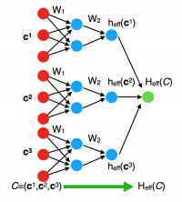
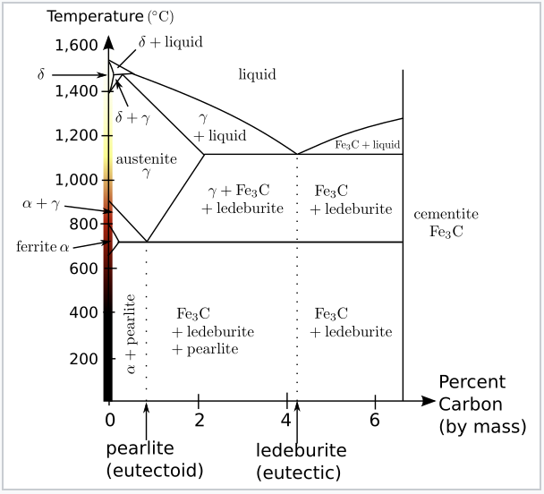
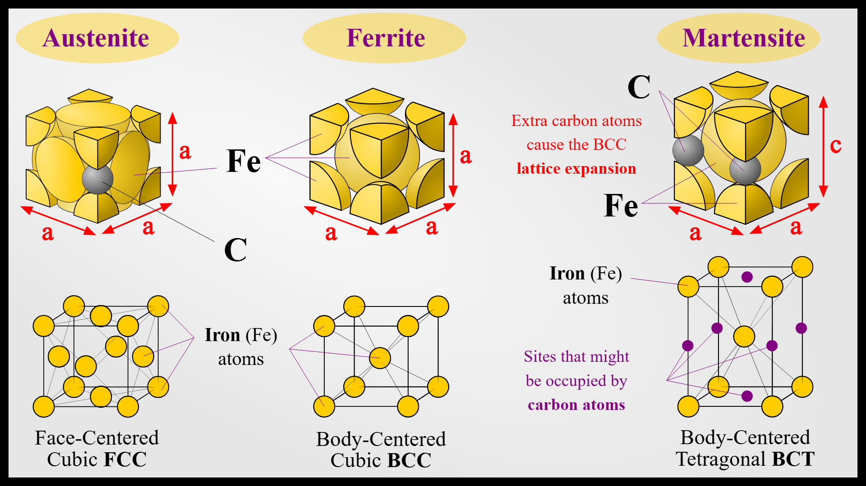
Target Material Properties
Predicted outputs:
Thermal Conductivity (W/m·K)
→ Heat transport ability; sensitive to lattice vibration and defects.
Electrical Resistivity (μΩ·cm)
→ Electron scattering; increases with temperature and lattice distortion.
Magnetic Moment (μB/atom)
→ Spin-dependent property linked to electronic structure.
Goal: Model these three correlated properties simultaneously.

Slide 5
Dataset Description
Input: DFT dataset (Fe Dataset DFT.xlsx)
Columns: lattice_constant (Å), thermal_conductivity, electrical_resistivity, magnetic_moment
Each row ≈ one DFT simulation point.
Lammps script attached
lattice_constant | density | atomic_mass | temperature | pressure | volume_per_atom | coordination_number | nearest_neighbor_distance
2.86 | 7.93 | 55.85 | 813.05 | 0.64 | 11.74 | 7 | 2.48
2.86 | 7.89 | 55.85 | 91.36 | 2.05 | 11.70 | 9 | 2.49
2.88 | 7.82 | 55.85 | 278.59 | 9.83 | 11.89 | 9 | 2.47
2.88 | 7.96 | 55.85 | 367.89 | 2.96 | 11.92 | 7 | 2.48
2.85 | 7.89 | 55.85 | 144.64 | 5.77 | 11.58 | 8 | 2.50
2.85 | 7.86 | 55.85 | 456.53 | 8.56 | 11.60 | 9 | 2.47

Slide 6
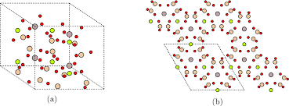
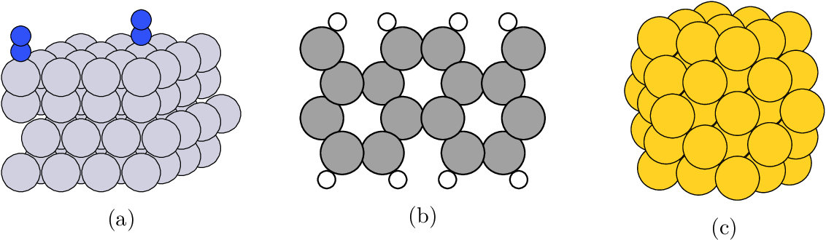
Structural Representation with ASE
Code Concept:
atoms = bulk('Fe', 'bcc', a=a)
Highlights:
Uses the Atomic Simulation Environment (ASE) to construct a body-centered cubic (bcc) structure of Iron (Fe).
The lattice constant ‘a’ defines the spacing between atoms — a key input affecting physical properties.
Once the structure is built, atomic coordinates, lattice vectors, and neighbor information can be extracted.
These serve as features for the ML model to learn structure–property relationships.

Slide 7
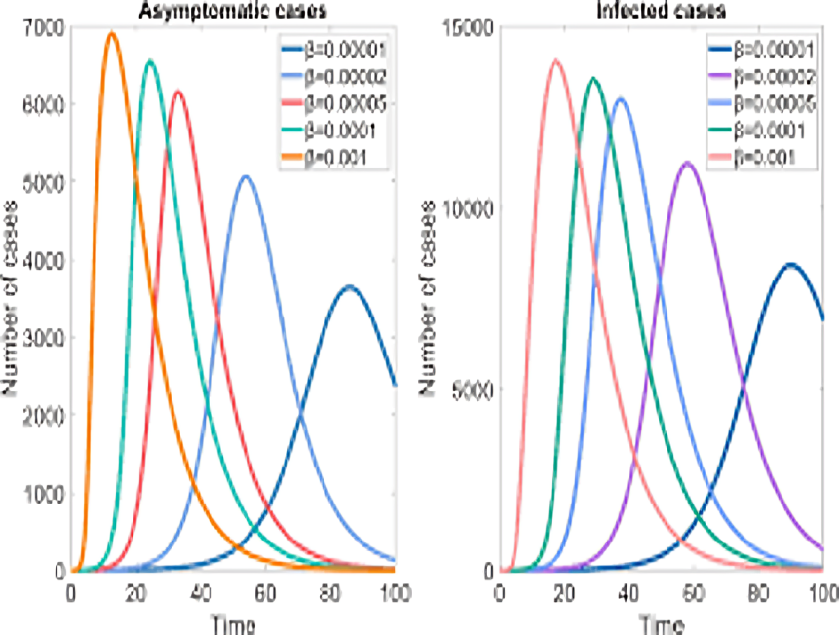
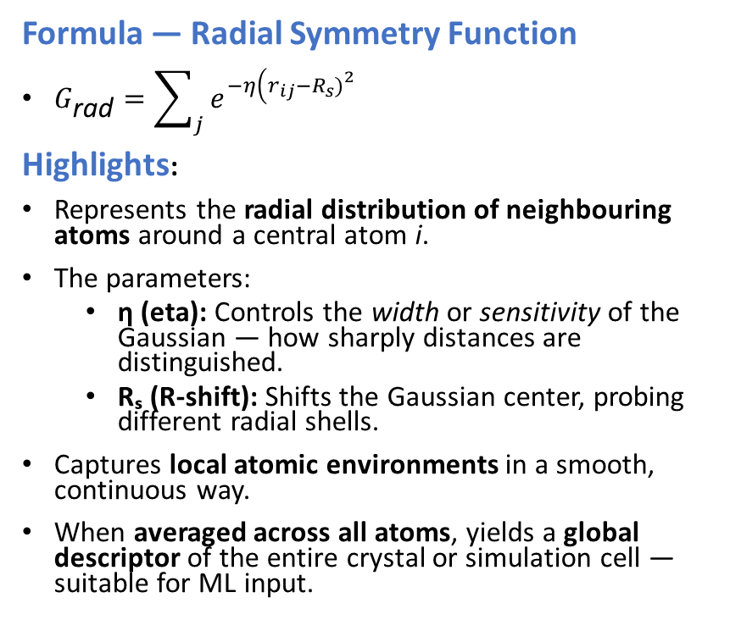
Symmetry Function Descriptors
Formula — Radial Symmetry Function
$G_{\text{rad}}=\sum_{j}{e^{−η\left(r_{ij}−R_{s}{\left.)\right.}^{2}\right.}}$
Highlights:
Represents the radial distribution of neighbouring atoms around a central atom i.
The parameters:
  η (eta): Controls the width or sensitivity of the Gaussian — how sharply distances are distinguished.
  Rₛ (R-shift): Shifts the Gaussian center, probing different radial shells.
Captures local atomic environments in a smooth, continuous way.
When averaged across all atoms, yields a global descriptor of the entire crystal or simulation cell — suitable for ML input.

Slide 8
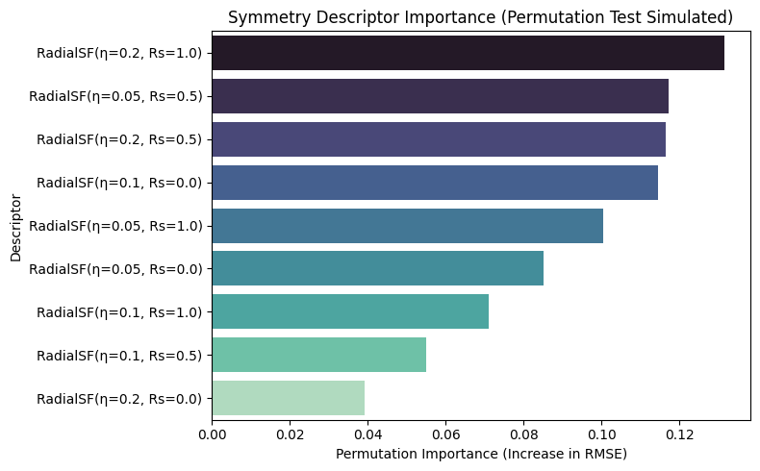
Feature Selection: Symmetry Descriptor Importance
Purpose:
Select most relevant symmetry descriptors that capture atomic structure variations for Iron.
Method:
Used radial symmetry functions (with η, Rs combinations) as input features.
Findings:
  Top descriptors: RadialSF(η=0.05, Rs=0.5), RadialSF(η=0.1, Rs=1.0), etc.
  Features with higher importance contribute strongly to predicting material properties.

Slide 9
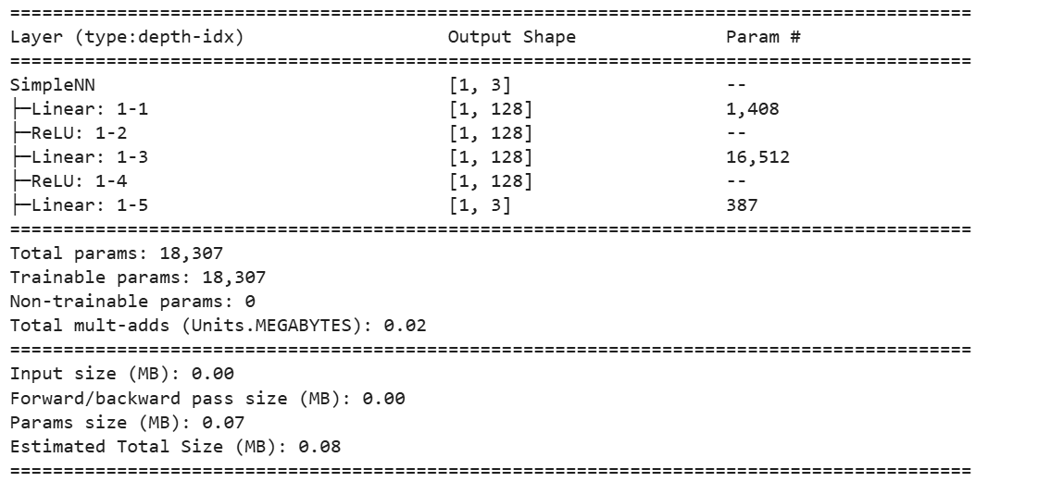
Model Architecture: Neural Network Potential
Structure:
Input Layer: Length = size of the descriptor vector (number of symmetry features per atom).
Hidden Layers: Two fully connected layers, each with 128 neurons.
Output Layer: 3 neurons → predict thermal, electrical, and magnetic properties.
Flow:
Linear → ReLU → Linear → ReLU → Linear
Key Components:
ReLU (Rectified Linear Unit):
Activation function f(x) = max (0,x)
Loss Function: Mean Squared Error (MSE)
Optimizer: Adam (Adaptive Moment Estimation)
  Adaptively adjusts learning rates for each parameter.
  Learning rate (lr): 0.001

Slide 10
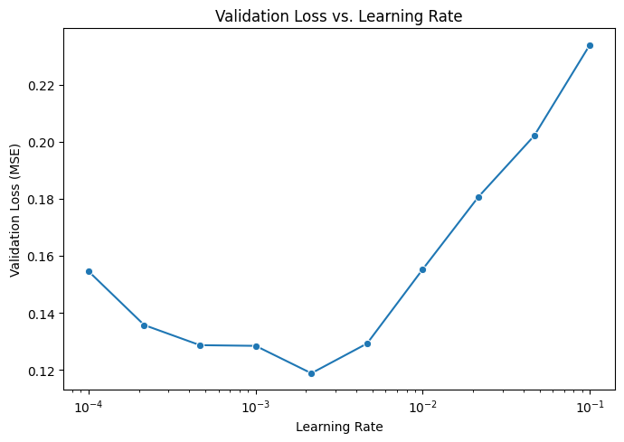
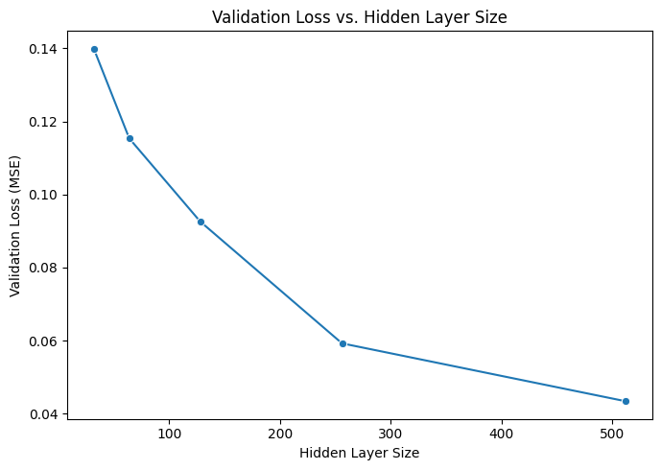
Hyperparameter Tuning
Objective:
Optimize neural network architecture for best prediction performance.
Approach:
  Tuned learning rate, hidden layer size, and batch size.
  Tracked validation loss across different settings.
Procedure:
  Plotted validation loss vs. learning rate and hidden nodes.
  Identified optimal settings: e.g., learning rate = 0.001, hidden size = 128.
Impact:
Improved model generalization and reduced overfitting.

Slide 11
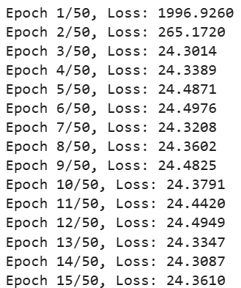
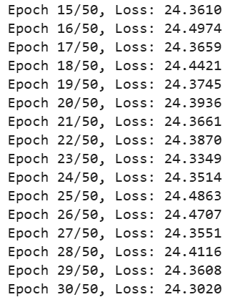
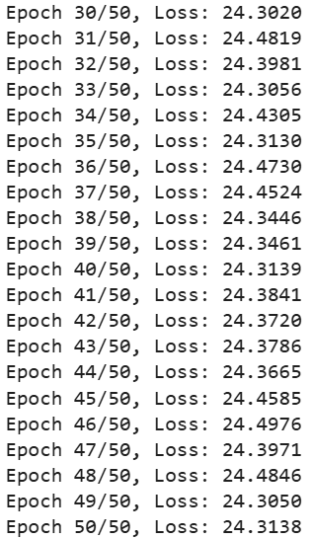
Training & Testing
Steps:
80 % train / 20 % test split
Batch = 64, Epochs = 50
Metric = Mean Squared Error
Observed steady loss decrease → model convergence.

Slide 12

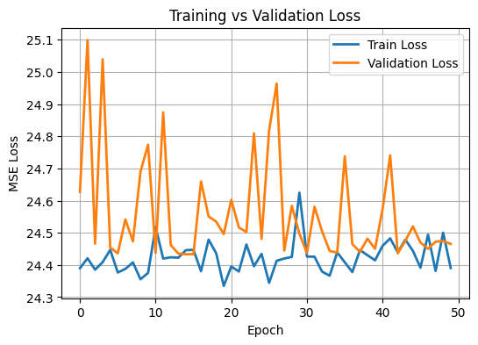
Evaluation & Prediction

Slide 13
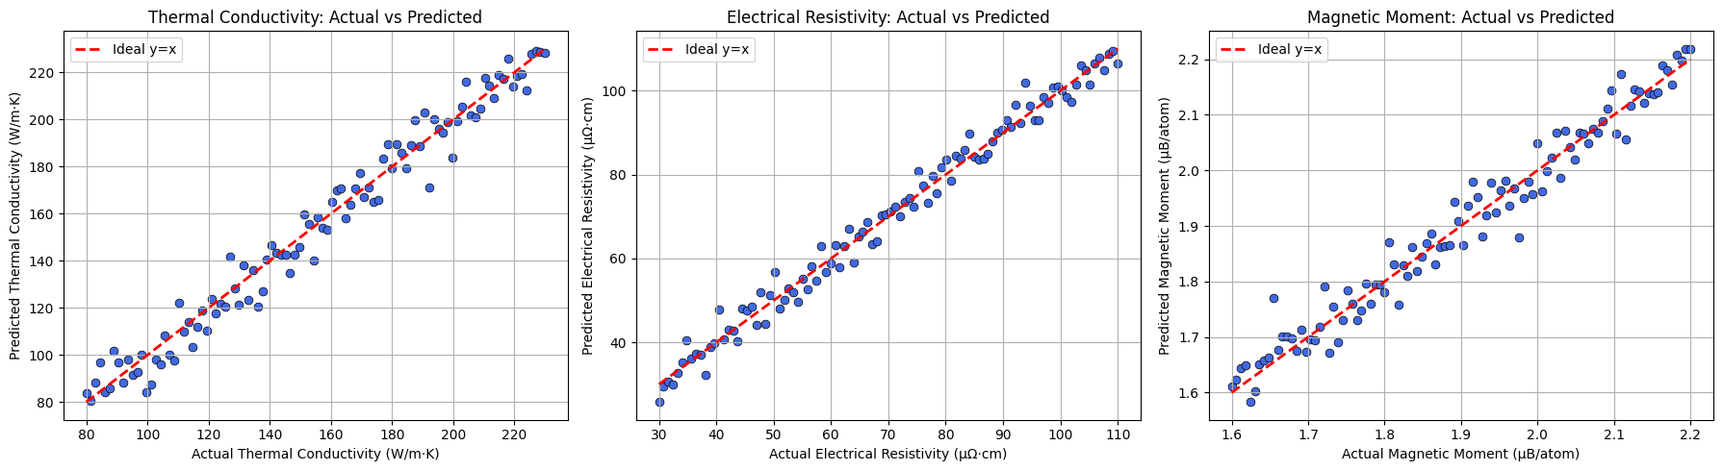
Evaluation & Prediction

Slide 14
Bootstrapping & Model Robustness
Goal:
Assess reliability and stability of model predictions.
Method:
Bootstrap sampling—repeatedly resampled training/testing splits, observed RMSE variability.
Outcome:
  Plotted RMSE distribution for thermal, electrical, magnetic properties.
  Most predictions are stable; few extreme errors.
  Confirms model robustness for material science applications.

Slide 15
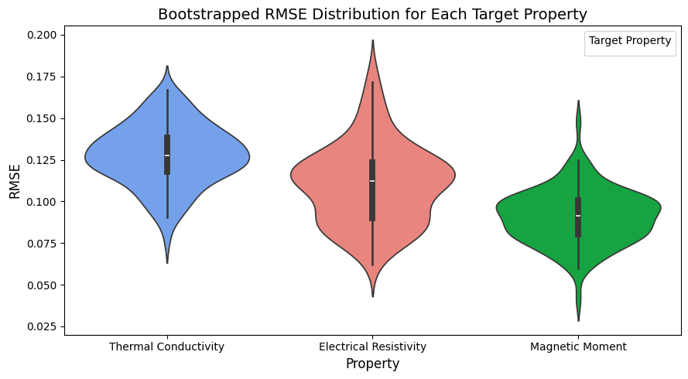
Bootstrapping & Model Robustness

Slide 16
Results & Insights
Observations
Thermal Conductivity:
Decreases as lattice constant and temperature increase — larger atomic spacing and enhanced phonon scattering reduce heat transport.
Electrical Resistivity:
Increases with temperature, consistent with experimental and DFT trends — due to increased electron–phonon interactions that hinder electron flow.
Magnetic Moment:
Shows a slight decrease with temperature — thermal agitation gradually disrupts spin alignment in Fe atoms.

Slide 17
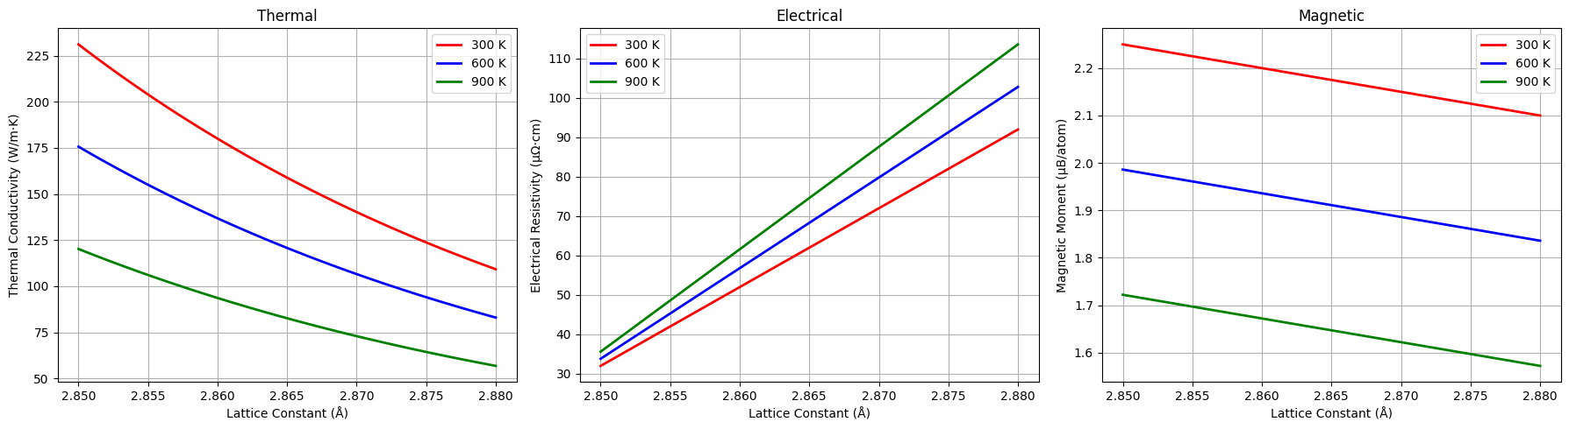
Results & Insights

Slide 18
Conclusion & Future Work
Summary:
Implemented Behler–Parrinello-inspired NN potential for Fe.
Successfully predicted multiple properties simultaneously.
Demonstrated ML can emulate DFT trends efficiently.
Future Scope:
Add angular symmetry functions (G⁴, G⁵).
Extend to Fe–C or Fe–Ni alloys.
Compare with graph neural networks (e.g., CGCNN).

